Slide 1
Laravel vs
CodeIgniter
Tymo de Kock

Slide 2
Content
Installation
Benchmarking
Features
Conclusions

Slide 3
Step One: Installation

Slide 4
CodeIgniter - Installation
Download package
Unzip in folders
Upload to server
Adjust config.php
Adjust database.php
NO CLI
NO INSTALLER
Still relatively easy!

Slide 5
Laravel - Installation
Use Composer
Add to PATH
Laravel new <project>
Config .env
Prerequisites: Apache
Homestead possible
Lots more documentation
CLI
Easy dependency management with composer

Slide 6
Benchmarking

Slide 7
Benchmark Specs
Laravel
Laravel 5.4 demo application
Cloudways Managed DigitalOcean server : 8GB
PHP 7.0
Test Duration: 5 min
No of Users: 250
CodeIgniter
Cloudways Managed Linode server : 2GB
Datacenter: Bangalore
PHP 7.0
No caching libraries
No of Users: 50, Requests 500-1000
Codeigniter 3.x with PHP 7.0

Slide 8
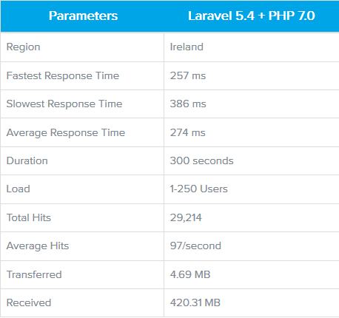
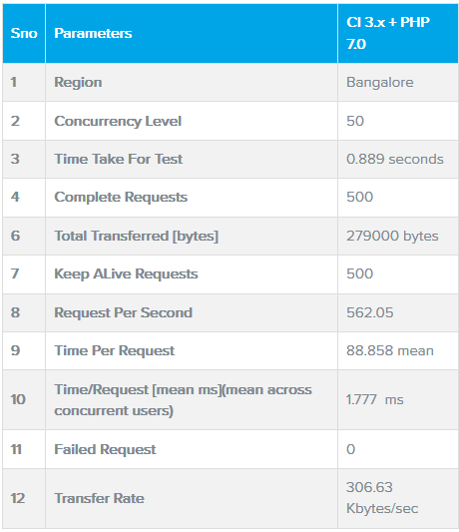
Benchmark Results

Slide 9
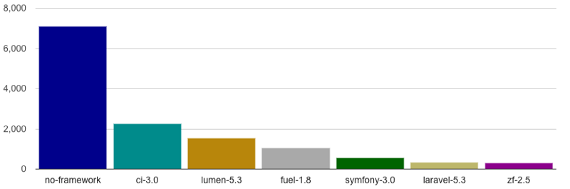
Comparisons - Requests Per Seconds
(Higher is better)

Slide 10
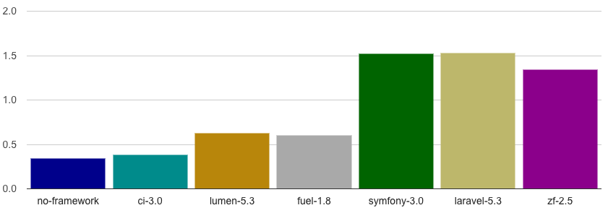
Comparisons - Memory Usage
(Lower is better)

Slide 11
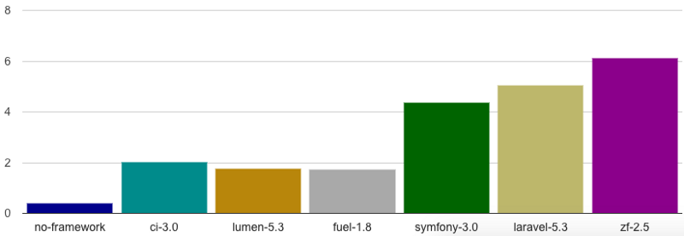
Comparisons - Execution Time
(Lower is better)

Slide 12
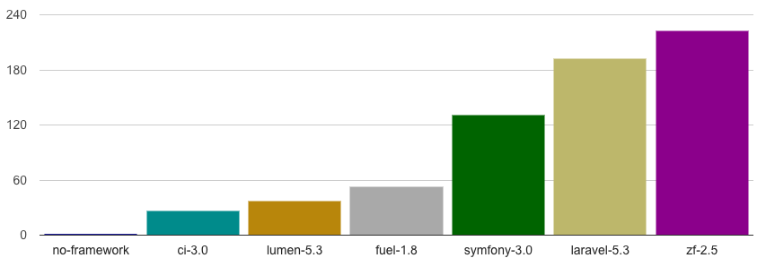
Comparisons - Included Files
(Lower is better)

Slide 13
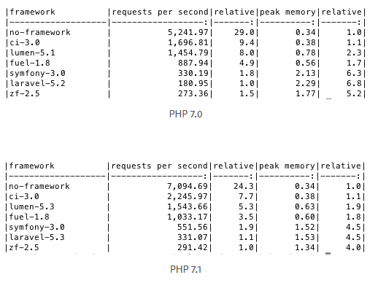
Comparisons - PHP versions

Slide 14
Conclusies
CodeIgniter a lot more light-weight
Less features, though, more about this later
Laravel is improving on its load
Less memory usage, for example

Slide 15
Features

Slide 16
Features
Laravel CodeIgniter
ORM: Yes
Packaged Module: Yes
Inbuilt user Auth: Yes
Inbuilt Captcha: No
Templating Engine: Blade
Code generator: Yes
Namespaces: Yes
Inbuilt CLI: Yes
Log management: Yes
And more
ORM: No
Packaged Module: No
Inbuilt user Auth: No
Inbuilt Captcha: Yes
Templating Engine: Php proprietary
Code generator: No
Namespaces: No
Inbuilt CLI: No
Log management: Yes

Slide 17
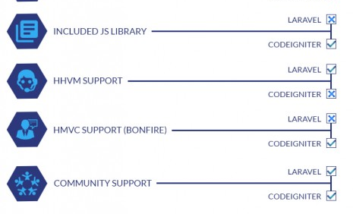

Slide 18
Popularity
Laravel incredibly more popular
Even at work AND personal projects.

Slide 19
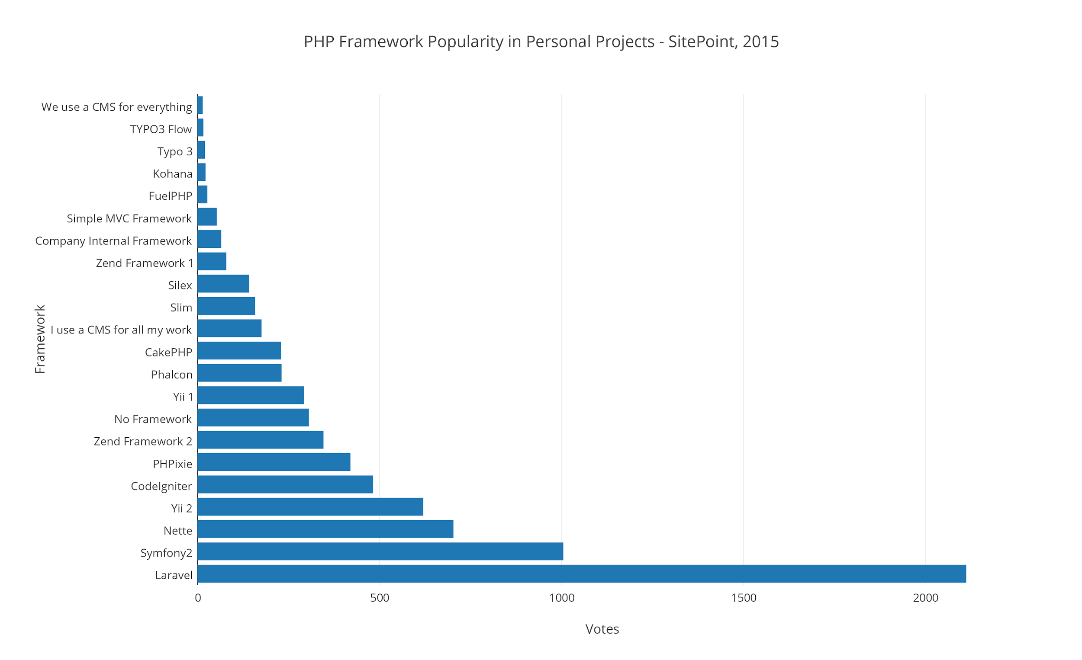
Popularity
Laravel incredibly more popular
Even at work AND personal projects.

Slide 20
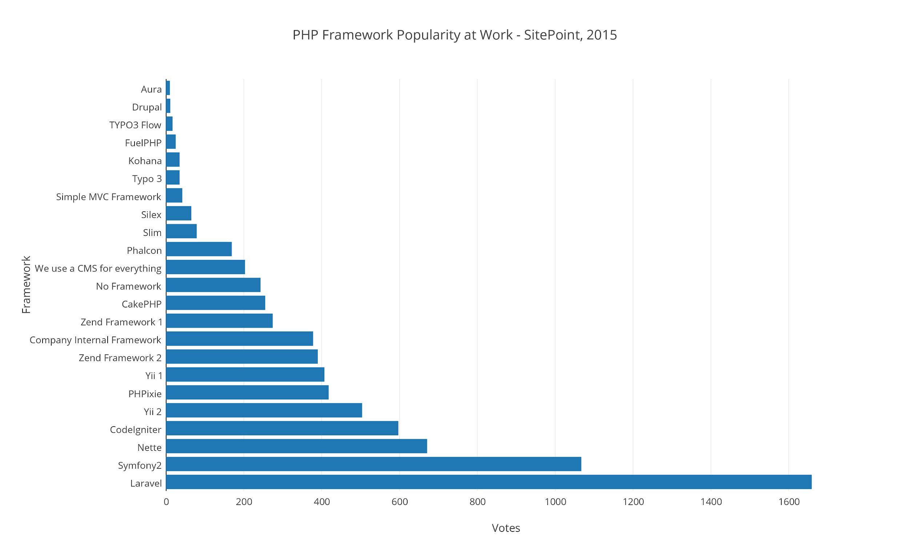
Popularity
Laravel incredibly more popular
Even at work AND personal projects.

Slide 21
Some further conclusions
Laravel seems to be more meaty
A bit more complex than CodeIgniter, however
More features, more complexity
Laravel has more quality-of-life options
Database management is easier with Laravel and it’s ORM
CodeIgniter is good for beginners
CodeIgniter is a lot faster and compact

Slide 22
Final Conclusion
CodeIgniter is for smaller systems, easier to maintain and a lot simpler
Laravel is more heavy-weight but can do a lot more
Both have incredibly thorough documentation, making them both easy to work with
One of the main reasons people use Laravel is its ORM-functionality

